Slide 1
Research Proposal
EVALUATION OF REQUIRED SKILLS AND COMPETENCIES IN CONSTRUCTION PROJECT MANAGEMENT:
ANALYSIS OF JOB ADVERTISEMENT POSTS FOR CONSTRUCTION PROJECT MANAGERS TO FIND THE MOST SOUGHT-AFTER SKILLS AND COMPETENCIES IN THE INDUSTRY, AIDING INFORM TRAINING PROGRAMS AND EDUCATIONAL CURRICULA
Submitted by:
Pair No. 01
SAMHITHA CHICKBALLAPUR NAGENDRA [12212478]
HARSHIL DIPAKKUMAR PATEL [12208041]

Slide 2

Introduction
The construction industry has a vital role in shaping the modern world, and successful construction project management is necessary for the timely and economical completion of projects. The duties of a construction project manager are multidimensional, including coordination, planning, budgeting, management of risk, and communication with different stakeholders. To outshine this dynamic field, professionals require various skills and competencies (Pariafsai & Behzadan, 2021).
Aim & Objective
The research aims to analyze job advertisements for construction project managers to classify the industry's most sought-after skills and competencies. With an understanding of the set of skills that employers order, this study notify training programs and educational curricula, assuring that aspiring project managers are prepared with the proper expertise to be successful in their careers.

Slide 3

RESEARCH QUESTIONS (RQ) AND OBJECTIVES
RQ1: What are commonly mentioned skills and competencies for construction project managers in job advertisements?
Objective: To identify skills and competencies in individuals who can effectively lead and manage construction projects to successful completion and thereby maintaining high standards of quality.
RQ2:Are there any particular industry trends or emerging skills progressively more sought-after by employers in construction project management?
Objective: To implement soft skills effectively and offering training on BIM and effective utilization of digital technologies.
Objective: To adapt and learn new skills quickly sought by the employers in construction project management.
RQ3:How do the needed skills and competencies change according to project size, geographical location, project type, and the implications for education and training programs?
Objective: To forecast the nuances of each particular situation, education and training programs and also recognizing the project managers who are capable of addressing specific challenges.

Slide 4
Research Methodology
Since this study aims to describe and analyse the issues and their mitigation related to required skills and competencies for construction project manager , mixed method approach i.e. qualitative and quantitative is more appropriate. The research is driven by study's goals and research questions, to collect data for the study through online interviews and systematic approach ( Framework ) .
Systematic approach is followed to identify and compare the project manager competencies from supply and demand side.
Provides communication to potential candidates through job advertisements.
Utilizing project manager competencies from academic, regional and industry perspectives.
Category creation
Quantitative
Online websites
Content Analysis
Data collection
Qualitative
Search contents

Slide 5
Qualitative Approach V/S Quantitative Approach
Qualitative Approach | Quantitative Approach
Interpretation based, descriptive Helps us to understand why, how or what happened behind certain behavior Example Gender Marital Status Qualifications Skills | Number based, Numerical, countable or measurable. Tells us how many, how much or how often in calculations Example: Age Income Experience

Slide 6
Data Collection STEPS :
Step 1 :
SEEK and INDEED Ads for the post of Project Construction Manager is selected from various list.
Step 2 :
Artifact of the detailed advertisement are collected in word Document
Step 3:
Variable lists are identified and listed as per the requirement mentioned as per the qualitative and quantitative approach
Step 4:
Based on step 3, data are collected and analyzed and by plotting the graph to identify area of strength and weakness.

Slide 7

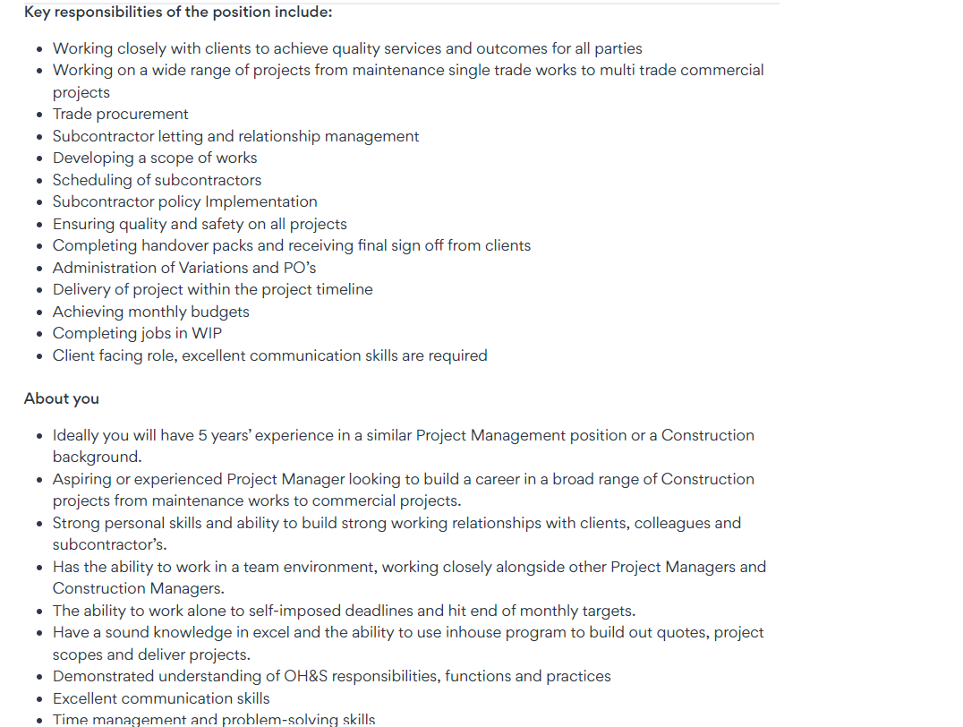
Job Advertisements

Slide 8
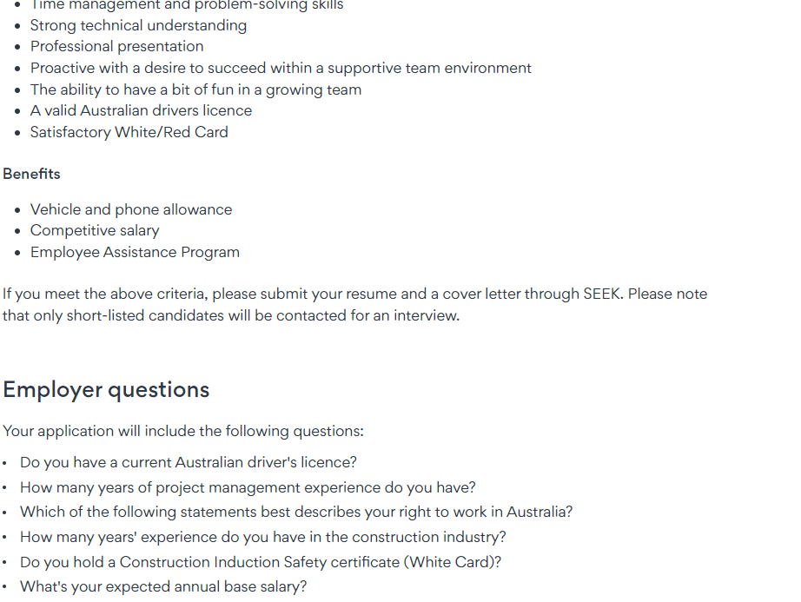

Slide 9
VARIABLE LIST
Ads | Qualification | Working Rights | Sector | FIFO/ DIDO | Previous Experience | Leadership | Management Skills | Trade Certificate | Induction Safety Certificate ( White) | Australian Regulation | Relocation to other location | Software Skills | Driving Licence Class "C" | Soft Skills Communication | Soft Skill Interpersonals
SEEK | 95.92% | 44.90% | 48.98% | 38.78% | 100.00% | 85.71% | 91.84% | 42.86% | 32.65% | 59.18% | 44.90% | 51.02% | 46.94% | 97.96% | 97.96%
INDEED | 55.38% | 67.69% | 56.92% | 15.38% | 93.85% | 69.23% | 95.38% | 36.92% | 7.69% | 53.85% | 20.00% | 55.38% | 20.00% | 98.46% | 89.23%
COMBINED | 75.65% | 56.30% | 52.95% | 27.08% | 96.92% | 77.47% | 93.61% | 39.89% | 20.17% | 56.51% | 32.45% | 53.20% | 33.47% | 98.21% | 93.59%

Slide 12
Result:
It is clearly evident form the graph that, variable like qualification, previous experience and soft skills are commonly mentioned and required in advertisements as the first priority and mandatory
Other variables like Leader ship skills, Australian regulation and software skills are on the second priority.
Remaining variables like driving license, working rights and many more are mentioned and required with least priority.
Overall to have a competent construction / project manager all the above priority lists are to be included in the job advertisements. As per the previous example.
Company will identify and accommodate as per the requirement and needs from time to time.

Slide 13
Personal Reflection By Harshil
Initially, my colleague and I finished the basic work for our research project last term. This included the topic section, journal analysis, literature evaluation, methodology, and other components.
This semester, our focus is on analysing job advertisements from Indeed and Seek for positions as project managers and construction managers. My colleague and I split up the work for that, with me being responsible for gathering information from Indeed and doing analysis for our study project. After compiling and debating the information, we discovered that some of the adverts were repeated on both websites. As a result, we felt it was necessary to remove those commercials and locate new ones that would better suit our needs.
In general, working on real-time advertisements has made me feel more confident as I can investigate the demands of our industry and what businesses look for from experts.

Slide 14
Personal Reflection By Samhitha
As this is the continuation of our Research project part 1 where we have completed our literature review , methodology part.
Firstly ,we started with the quick brainstorm sessions that what needs to be done in the next part . With the guidance of our unit coordinator and the meetings with our supervisor we started analyzing that what steps we have to follow in order to ensure smooth flow of the project.
Then we started collecting job advertisements from Indeed and Seek as this is the initial step for the project . We divided this task to avoid the duplication and to ensure that all the factors are observed thoroughly .
It was a challenging part in order to take out the skills and factors required in each job advertisement and also the time management was crucial to us in this specific part.
After scrutinizing in depth of these job advertisements , we were able to compile and compare the information to get the initial results .
Overall , it’s a best part to work in team and with effective co ordination with my team mate , we exchanged our ideas and knowledge in order to achieve the best results.

Slide 15
Google Drive Access Link
Drive :
Samhitha C N
https://drive.google.com/drive/folders/1i5gCVqAZCkLLIH1OoVCunduOppidcYvO?usp=sharing
Harshil Patel
https://onedrive.live.com/?redeem=aHR0cHM6Ly8xZHJ2Lm1zL2YvYy9jN2RmNDMxMTU0YzRjNGYxL0V2TUs5X2l1SEhwRGtCS1h1UU5zTnhrQjdpUWFaeUQ2Zk8zSENzYllCaXBxVmc%5FZT1PZ0p5bHI&id=C7DF431154C4C4F1%21sf8f70af31cae437a901297b9036c3719&cid=C7DF431154C4C4F1

Slide 16
THANK YOU

